Slide 1
Group 7
NICK SPHAR, JOSE ROSARIO-LOPEZ, TIMMY YIP
IS 380
MARCH 15, 2017

Slide 2
Introduction: System Overview
Board games are in a golden age and there is a need for a system that handles loans from a library
Board Game Stores
Board Game Cafes
Board Game Clubs
The goal is an easy to implement inventory system that keeps track of games, players, and loans
The purpose is to make it easy to find games you want to play, and to foster a spirit of competition and community among gamers

Slide 3
User Requirements
Function List
The system should be able to keep track of and enable users to search for the following elements:
Players
Games
Copies of games
Loans
Add a Player | Add a Game | Add a Copy of a Game | Initiate a Loan
Update a Player | Update a Game | Update a Copy of a Game | Return a Game
Remove a Player | Remove a Game | Remove a Copy of Game | Search Loans
 | Search Games

Slide 4
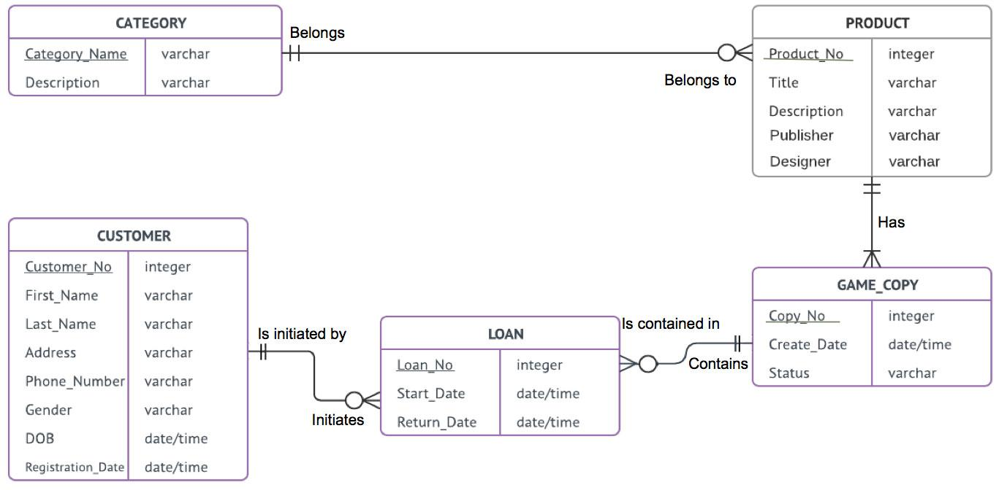
Database Design - Conceptual Design
Notes:
database design: structure of data base tables and/or non-database files;

Slide 5
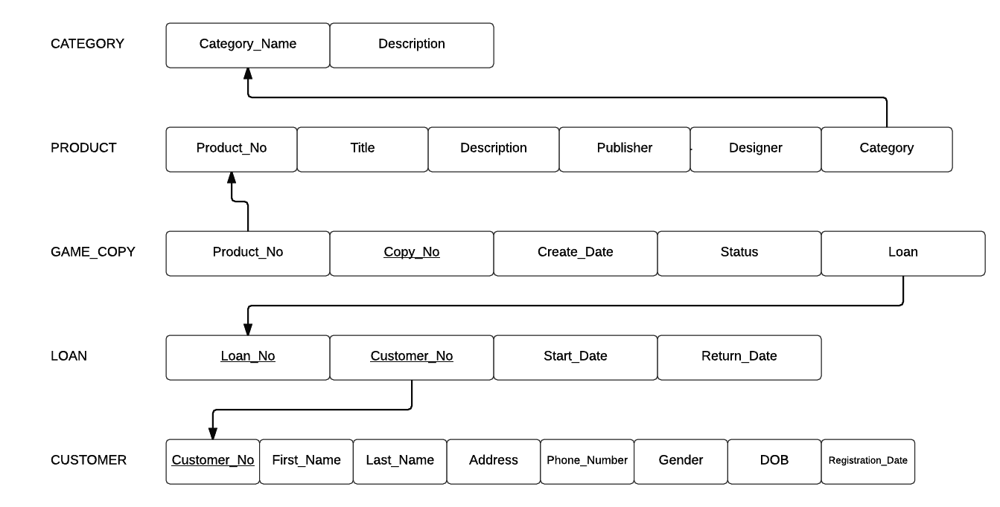
Database Design - Logical Design
Notes:
File or database design: structure of data base tables and/or non-database files;

Slide 6
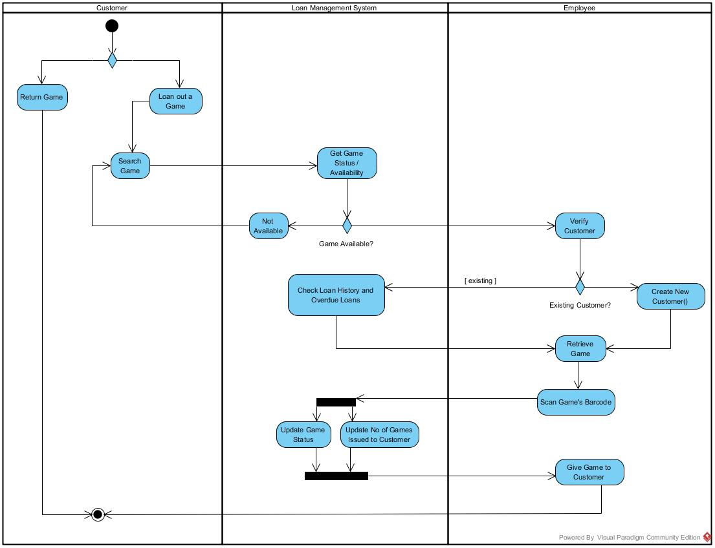
Activity Diagram
Notes:
Activity diagram and description: Illustrate the flows of processes included in the system;

Slide 7
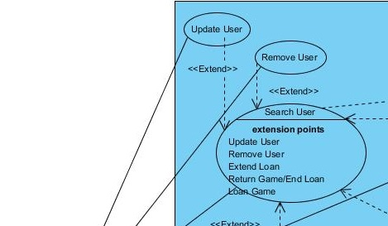
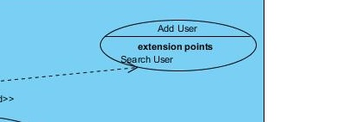
Use Case Diagram

Slide 8
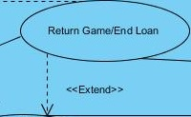
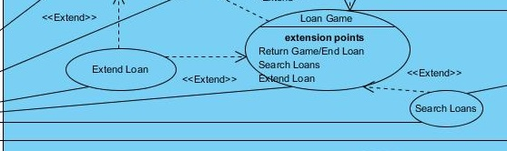
Use Case Diagram

Slide 9
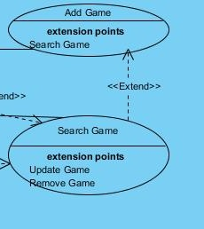
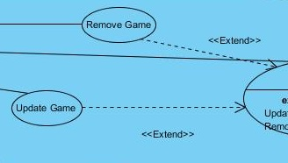
Use Case Diagram

Slide 10
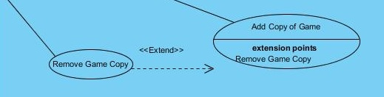
Use Case Diagram

Slide 11
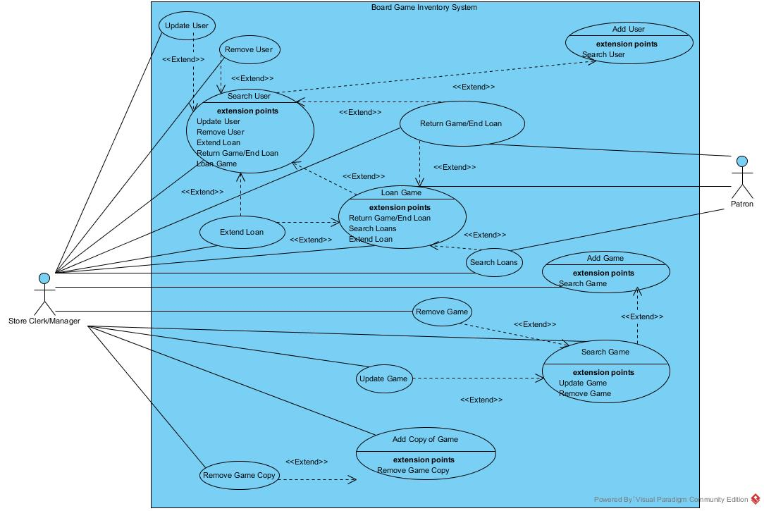

Slide 12
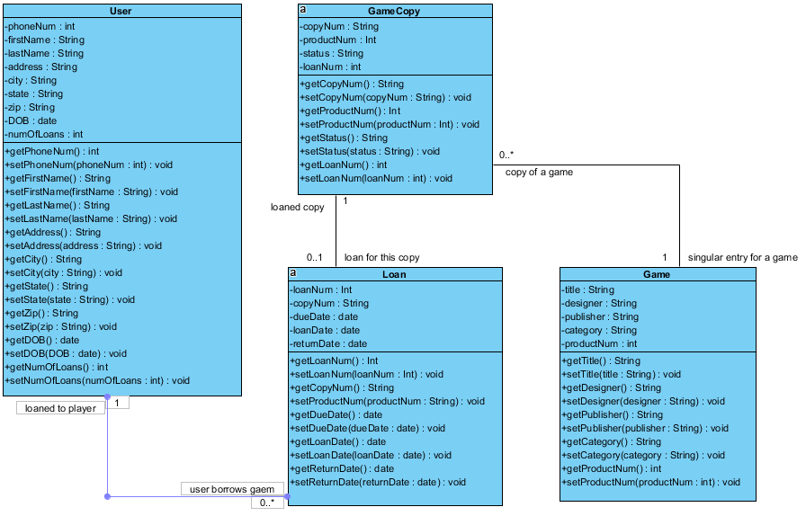

Slide 13
Questions?

Slide 14
Thank You

